Slide 1
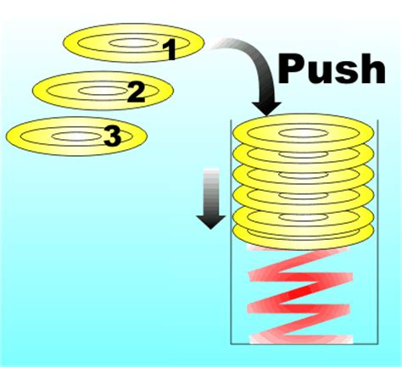
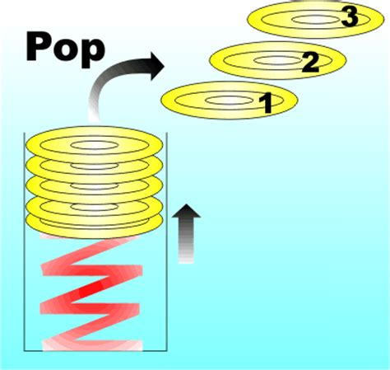
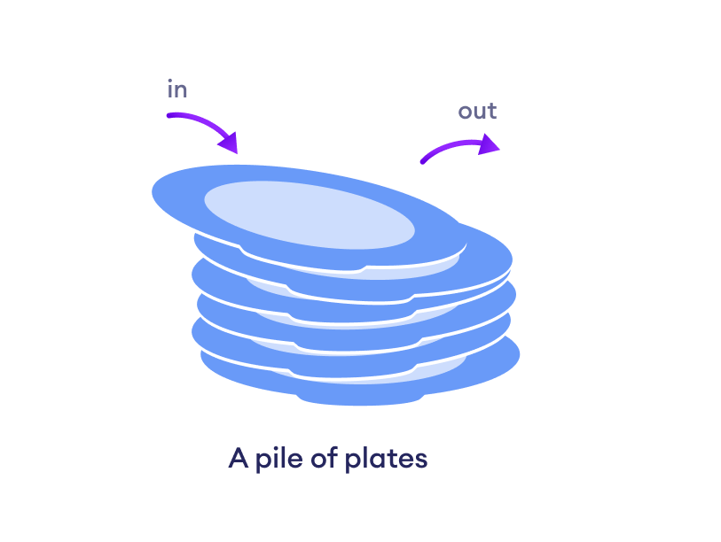

L03 Strings, Methods, 1D Arrays

Slide 2
Today
Pick 2 Emojis that represent:
How you feel about starting school
What your excited or nervous about
Check in:
Git/GitHub and Eclipse -
Were you able to set up?
Do you need help?
GE M01 Part 1 Questions?
F25_CS2050_Tentative_Schedule.xlsx
Get Set Up
Go today’s lecture and open slides as google slides or powerpoint - you will need to copy and paste code from slide
L🌻ve
L💗ve
La🤣gh
Le💡rn
Deb
🤩 Ready to work with you
Excite to learn💡but worried about 🔥 burnout

Slide 3
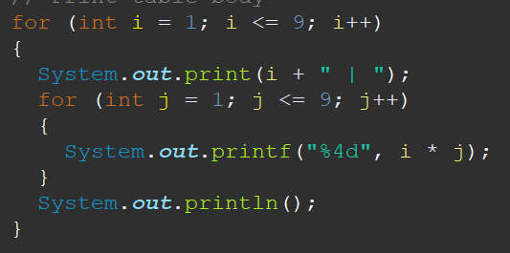
chars, Strings, 1D arrays
Put your name on paper
One person will do chars and Strings
Another person will do 1D arrays
2. Individually write down
words to describe and code samples
Visuals to represent and how stored in memory
3. Individually write the output for the nested for loop code
Discuss
chars, Strings and 1D arrays
Compare output and describe what was created in the nested for loop

Slide 4
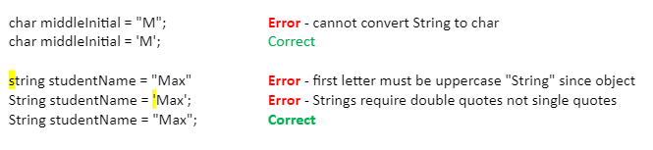
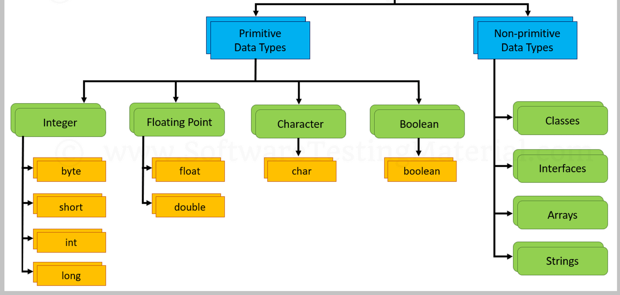
String and char
Remember a char is in single quotes and a String is in double quotes
char is a primitive data type
String is a non-primitive data type (String is a class)

Slide 5
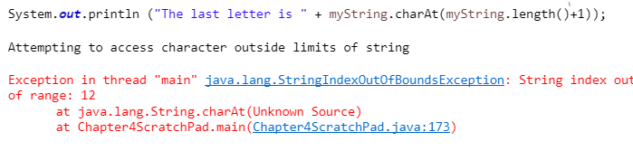
String Methods
length() Returns the number of characters in a string – for above string this is 11
charAt(index) Returns the character at the specified index within a string
Ends at length of string -1 since starts at position 0 the last index is 4 = 5-1
char
W | i | l | l | y
0 | 1 | 2 | 3 | 4
Index in string
Starts at position 0
Put in your code
Put in your code
Notice what happens if you try to access an index that doesn’t exist. For example there is nothing at index 6

Slide 6
String Review
char
W | i | l | l | y
0 | 1 | 2 | 3 | 4
Index position string
Index starts at position 0
Ends at length of string -1 since starts at position 0 the last index is 4 = 5-1
Notice what happens if you try to access an index that doesn’t exist. For example there is nothing at index 6

Slide 7
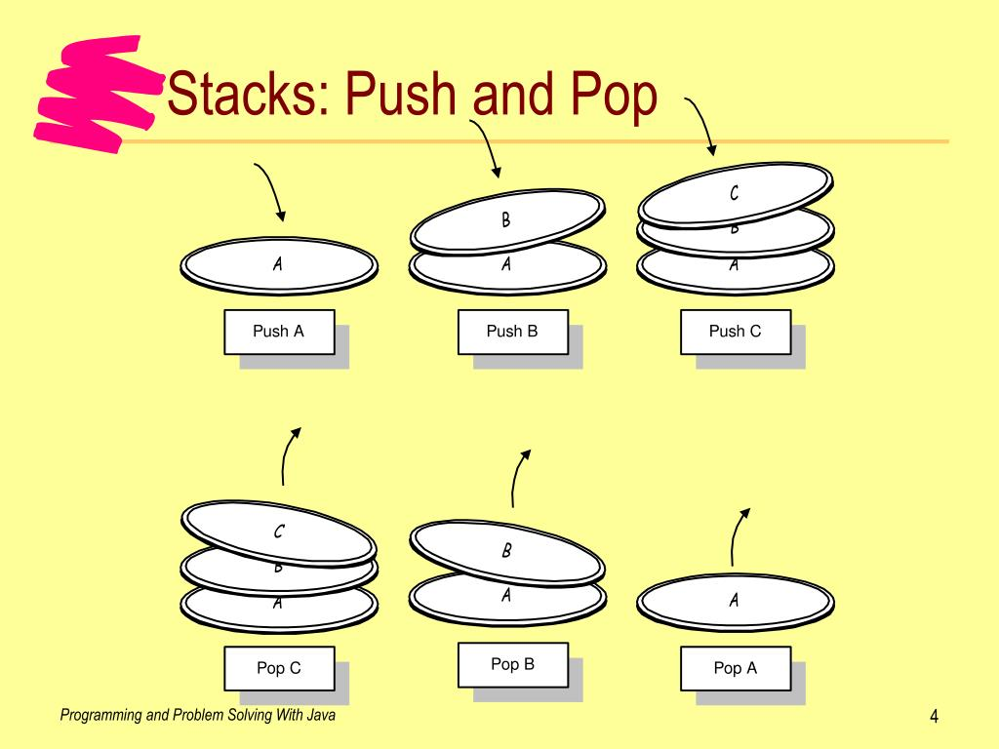
Call and Stack Frame
The call stack is used to keep track of active methods. Stacks are last in, first out (LIFO) last item pushed onto stack is 1st item popped off
The call stack is used to keep track of active methods. When method is called (invoked) information for that method called a stack frame is pushed onto the stack - (add) a plate onto the stack
Values of parameters and local variables (automatic storage duration)
Current line of code executing
Return address to return to calling function
Method on the top of stack is the current executing method.
Method stays on top until the ending curly brace is reached
When the Method returns (completes)
Information for that method is popped off the stack (frame is removed)
Memory local to that stack is deallocated
Think of stack of plates at buffet line

Slide 8
Scope
The different types of variables in a Java program are:
Local variables - declared in a method
Instance variables - declared within a class
Static variables - declared within a class
Scope in Context of a Class
Local variable - starts from its declaration and continues to the end of the block that contains the variable, such as
declared in for loop {block of code}
declared in method {block of code}
Instance variables and static variables scope is the entire class.

Slide 9

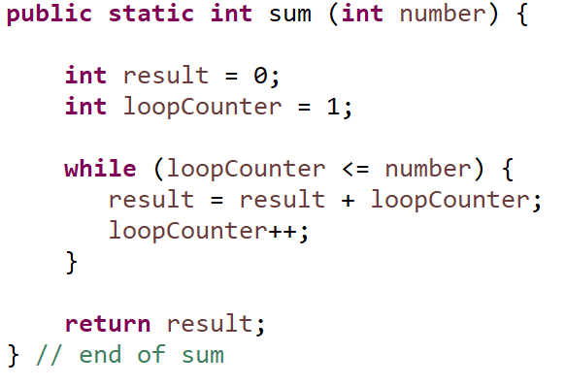
Review Scope
Section of a program that a variable is visible in
Local Variable
Variable that is defined inside a method
Scope is from point of declaration to end of block containing the variable
Must be initialized before you can use it
Notes
Formal parameters are considered local variables
General rule - the scope of a variable declared in a block is limited to that block
If you try to use a variable outside the block it is declared, you will get a compiler error

Slide 10
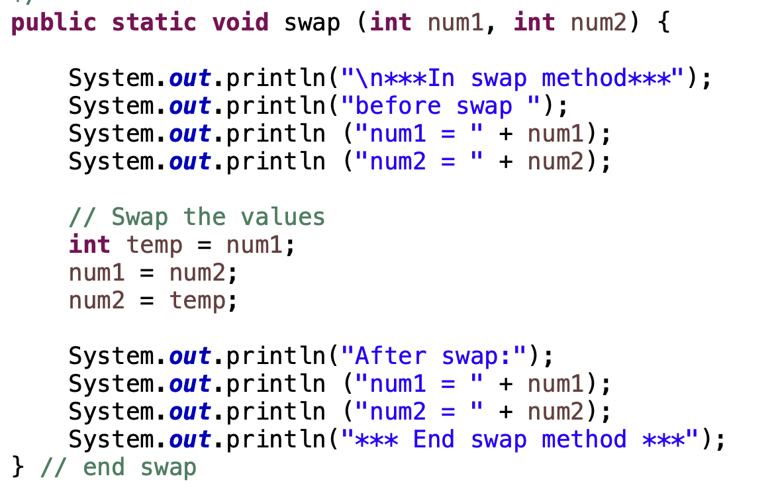
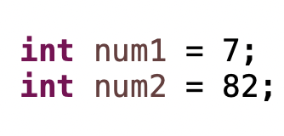
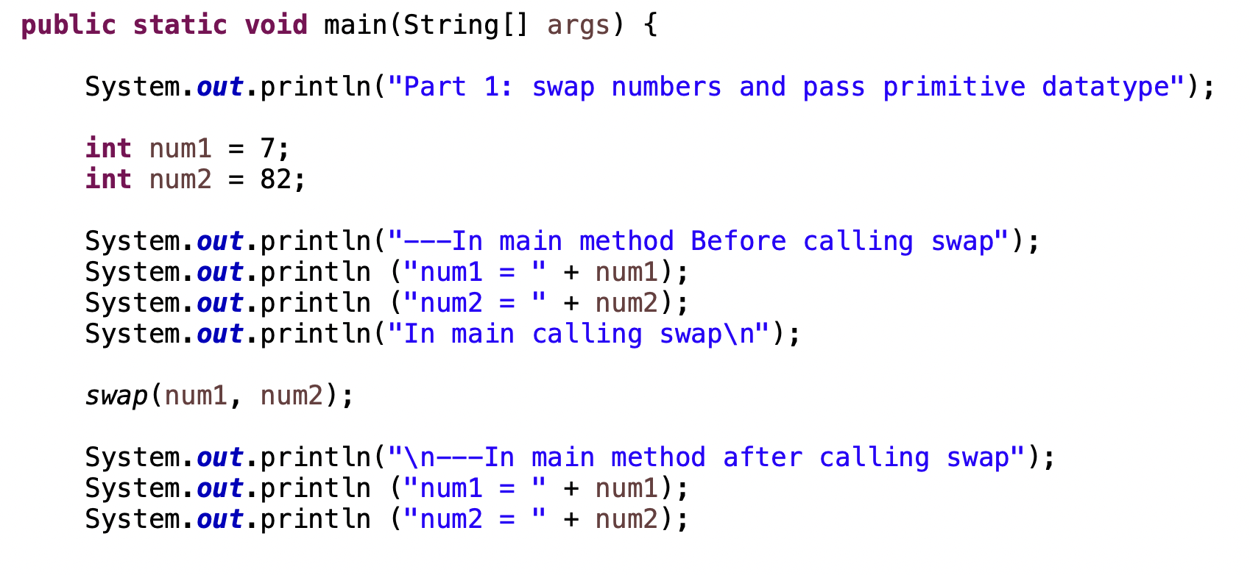
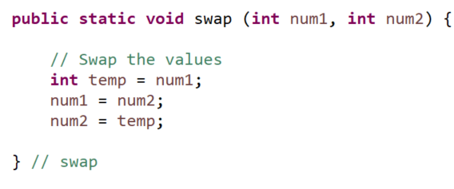

Memory and Calling Methods
swap
2. When main method calls swap method it allocates memory in a new location.
When variables are declared in swap method new memory is allocated
Variable declared in swap method only have scope in wasp method.
1. Main methods loads in memory first.
When variables are declared in main, memory is allocated in relation to the main method
Variables declared in main method { } only have scope in main.
m
ain
Since these are separate memory locations it is best practice to not use same variable names.

Slide 11
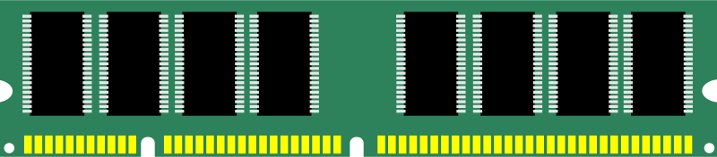
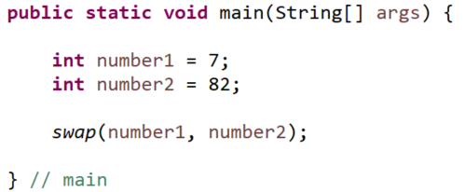

Methods, Stacks and Memory
Main method called first and stack created in memory for declared variables in main method.
Then swap invoked (called) and another stack of memory for declared variables in swap method
These variables are in a separate stack of memory and once the method exits the memory is deallocated (deleted)
0x7fff6771c324
0x7fff6771c456
0x7fff677af799
Memory allocated with main stack
0x7fff6771h587
0x7fff6771g123

Slide 12
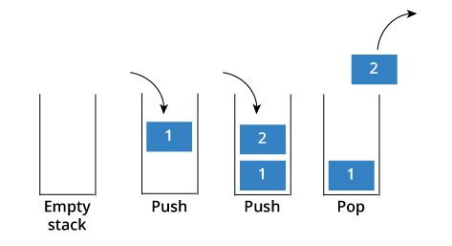



Call and Stack Frames
2 swap method stack
1 main method stack
User defined method swap ends and memory (parameters/local) released
Main method calls user defined method swap;
when variables (parameters/local) are declared space is allocated in memory based on the type
Main method ends and memory released
Run program calls main method; when variables are declared space is allocated in memory based on the data type

Slide 13

Pass by Value
When passing primitive data types from one method to another we are passing-by-value.
copy
copy
Pass by value means a copy of the value from one memory location is put in another memory location. Even if you would make the formal parameter names the same they are still located in two different memory locations. Remember to not use the same variable names for

Slide 14
Methods, Strings and Loops Review
public class M03LoopsConditinsMethods{
public static void main(String[] args) {
String startingString = "SquarePants";
methodOutputs(startingString);
System.out.printf("\nString after method: %s", startingString);
}
public static void methodOutputs(String stringParameterInput){
int stringLength = stringParameterInput.length();
for (int i = (stringLength-1); i >= 0; i--) {
char currentChar = stringParameterInput.charAt(i);
if (currentChar == 'a' || currentChar == 'e' || currentChar == 'i' ||
currentChar == 'o' || currentChar == 'u') {
currentChar = Character.toLowerCase(currentChar);
}
else {
currentChar = Character.toUpperCase(currentChar);
}
System.out.print(currentChar);
}
}
}
1. How is startingString is stored in memory?
2. What is the value in creating methods?
3. How is startingString passed to method?
4. How do you access different characters in the string?
5. Why is a for loop used here?
6. Why stringLength-1?
7. What is the String method length() doing?
8. What is the output? Use paper to help you.

Slide 15
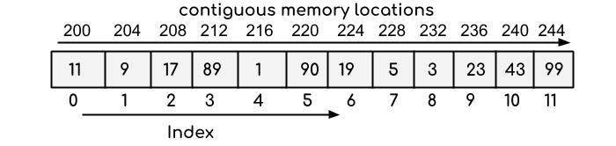
Arrays
An array is a data structure that provides a way to store more than one value but they must be the same data type. An array is a data structure.
An array is a group of contiguous memory locations that all have the same type.
Provides ability to store a fixed set of values of the same type
Can access that set of values through one variable name

Slide 16
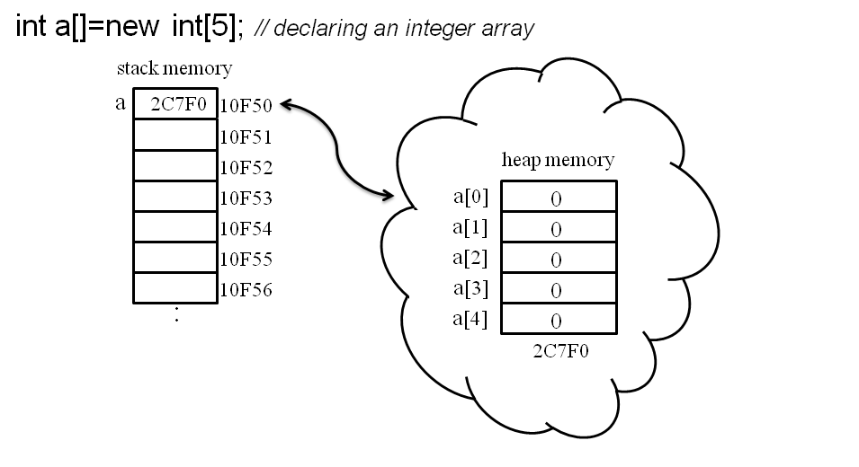
Declare Arrays
Declaring arrays works differently then primitive data types.
Int a[] means declare enough memory on the stack to hold an address.
New int[5] means declare enough memory on the heap to store 5 integers consecutively in memory
New int[5] returns the address on the heap where index[0] is located and assigns it to the a identifier

Slide 17

Declaring and Creating a New Array Object: Memory
variable for an array is a reference variable
Identifier numbers had a memory location holds null until new array created with a size
Declaring array creates memory on the stack for the numbers variable to store the address to refer to where the array will be in memory on the heap. When not initialized it stores null.
numbers
009AFD30
null
TOTAL_NUMBERS = 5
New allocates memory on heap to store each integer
Array name numbers now contains memory address on heap where array starts at index 0. The heap is not on the stack
0x7fff6771c324
Memory for each integer is stored consecutively in heap memory
numbers
009AFD30
0x7fff6771c324

Slide 18
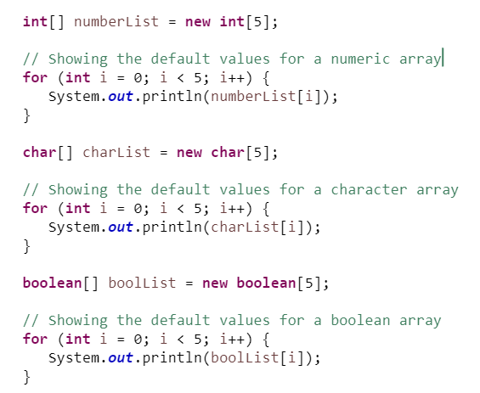
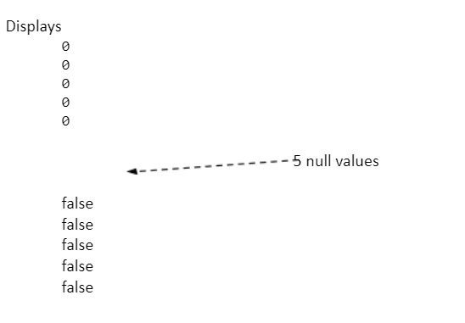
Array Defaults
Unlike other types, when an array of primitives is created, it is filled with default values
The default value is based on the element type the array will store
zero for numeric
\u0000 - for char type - this is Unicode for "null"
false for Boolean type

Slide 19
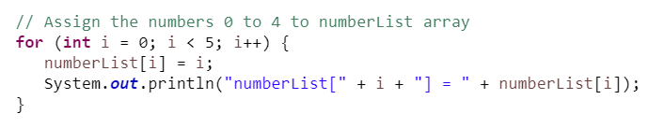

Initializing an Array
Initialize with a for loop
With arrays, we can write a statements where the array is declared, created, and initialized an array in one statement with a list of numbers. In this case, the new statement is not used with this approach.
This creates enough memory to store 5 integers.
I use this to test methods instead of entering values.

Slide 20
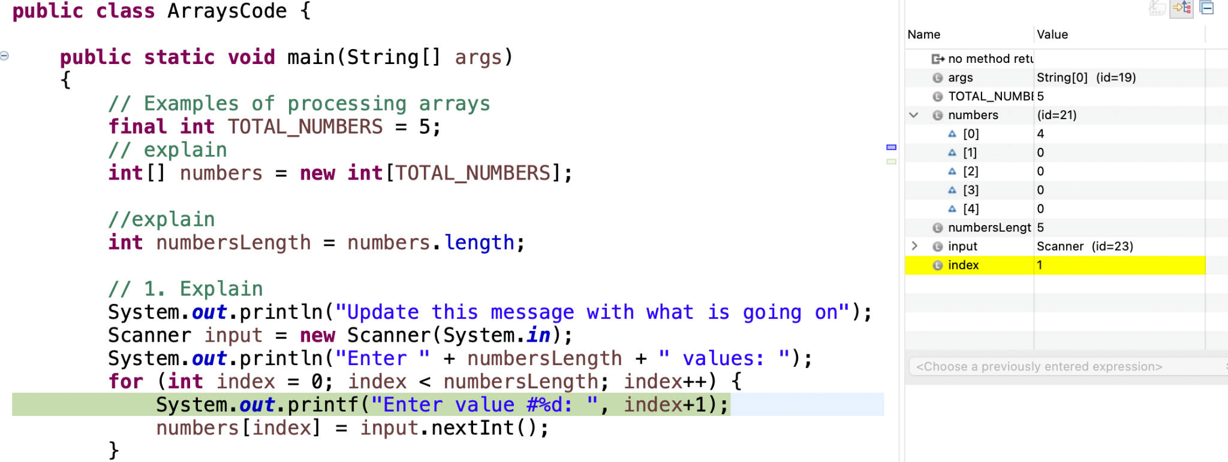
Accessing Array Elements
When you are in Eclipse you will notice array name numbers value is id=21.
That is because numbers is a reference variable holding where in memory to go on the heap where array starts
First index is 0
Variable index in for loop increments

Slide 21

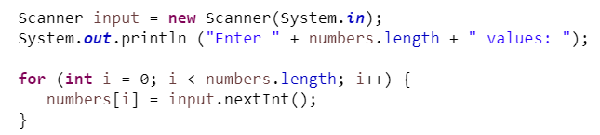
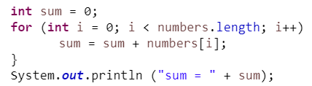
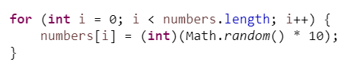
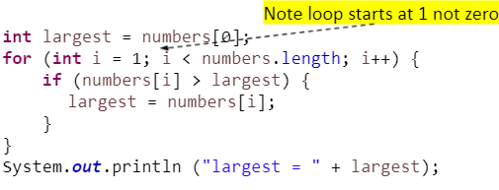
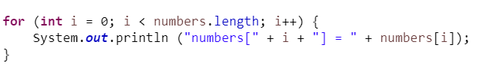
Examples of Processing 1D Arrays
Initialize with input values
Sum Elements
Initialize with random values
Find largest element
Display Array

Slide 22


Explore & Discuss
public class AnalyzeGrades
{
public static void main(String[] args)
{
java.util.Scanner input = new java.util.Scanner(System.in);
System.out.print("Enter the number of items: ");
int totalGrades = input.nextInt();
double[] grades = new double[totalGrades]; // array of grades
double sumGrades = 0;
System.out.print("Enter the numbers: ");
for (int i = 0; i< grades.length; i++)
{
grades[i] = input.nextDouble();
sumGrades += grades[i];
}
double average = sumGrades / grades.length;
int countAboveAverage = 0; // The numbers of elements above average
for (int i = 0; i < grades.length; i++)
{
if (grades[i] > average) // Count if number[i] > average
{
countAboveAverage++;
}
}
System.out.println("Average is " + average);
System.out.println("Number of elements above the average is "
+ countAboveAverage);
}// end of main method
}// end of driver class
Run Animation AnalyzeNumbers.
Create 3 items in the array
Discuss
Declaring array and how stored in memory (stack and heap)
Algorithm to iterate through an array
Why for loops?
What would happen if sum and n were integers when finding the average?
Algorithm to find
Sum
above average
How could this be implemented better to make it easier to maintain and test?
Why does Deb’s code look different compared to animation

Slide 23
Some of Deb’s Style Guide for this Class
Naming Conventions - Java
Braces are used with if, else, for, do and while statements, even when the body is empty or contains only a single statement.
One declaration per line since it encourages commenting
Put declarations only at the beginning of blocks.
Do not use ternary operator for this class. While the ternary operator is useful for simple conditions, it can make code harder to read if overused or used with complex logic. In such cases, traditional if-else statements may be clearer.
You will receive a full style guide for your project iterations in the next module.

Slide 24
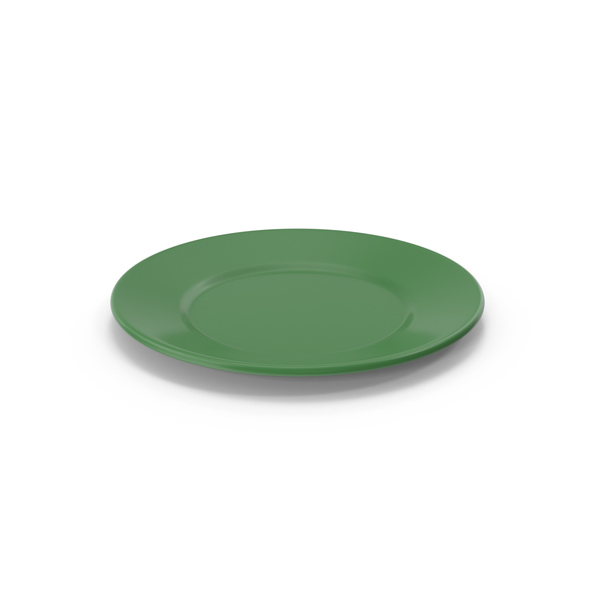

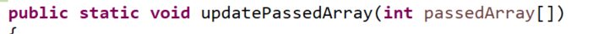

Passing by Reference and by Value
Pass by value means a copy of value on method stack (main) is passed.
Pass by reference means a memory address is passed which defines where to find information on heap.
1c324
1c388
Pass copy of address from method stack (main) that reference memory on the heap
copy
copy
Both array3 and passedArray reference same memory location on the heap so any updates to array are to same array.
1c456
Heap id24
1c589
Copy is put in new memory location on swap method stack.
When updatePassedArray method stack memory is deleted the heap memory is not.

Slide 25
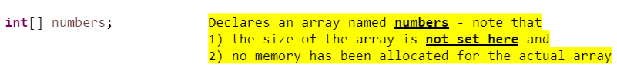
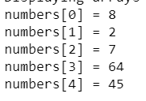
Rules for Arrays
Once created, an array's size is fixed
All elements in an array will be the same type
The array declaration does not allocate memory for the array
You cannot do anything with array variable numbers until array is constructed with the new operator
After array is created (allocated memory): The value stored in array variable is now the address of the array. A reference variable is used to access the items in an array
To reference an item in an array on the heap use "bracket" notation
Once an array is created it has an associated length variable
Attempting to access an element with an index outside the range of the array is a out of bounds runtime error
numbers stack reference variable holds null since the array was not created yet.
Array reference variable numbers on the stack refers to where array is located in consecutive memory on the heap

Slide 26
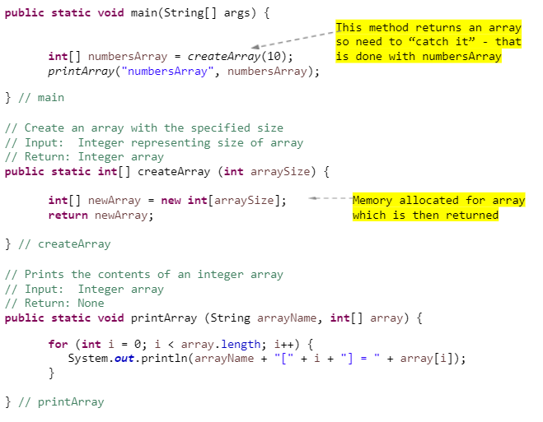
Create an Array in Method
You learned how to return primitive data types from methods. You can also return reference variables hold array address on the heap from a methods.
The MEMORY allocation for the array is done within the method!
When control returns to the main, numbersArray it returns the id of the memory on the heap where the array is stored
Assigns address where array is located on the heap.
Returns address where array is located on the heap

Slide 27
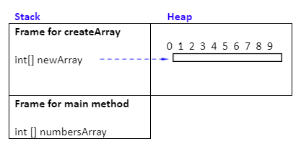
Method Stack running Create Array
Main calls createArray - a frame for createArray method is pushed onto stack
Memory is allocated on the heap for newArray inside createArray method
newArray is a reference to that memory
newArray reference is returned from the method, that is, an address to array is returned

Slide 28
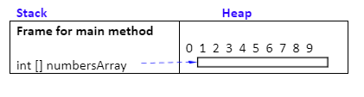
Popped off the stack and back in main
Stack frame for createArray is popped off the stack
newArray variable holding address no longer exists on the createArray stack
But the memory on the heap it was pointing to is now pointed to by numbersArray

Slide 29
Pair Program
public class AnalyzeGrades {
public static void main(String[] args) {
java.util.Scanner input = new java.util.Scanner(System.in);
System.out.print("Enter the number of items: ");
double[] grades = {10, 7, 8}; // array of grades
double sumGrades = 0;
System.out.print("Enter the numbers: ");
for (int i = 0; i< grades.length; i++)
{
sumGrades += grades[i];
}
double average = sumGrades / grades.length;
int countAboveAverage = 0; // The numbers of elements above average
for (int i = 0; i < grades.length; i++)
{
if (grades[i] > average) // Count if number[i] > average
{
countAboveAverage++;
}
}
System.out.println("Average is " + average);
System.out.println("Number of elements above the average is "
+ countAboveAverage);
}// end of main method
}// end of driver class
Copy code from the left text box into Visualize Code
Step through visualizer and discuss what is on stack and heap
Take Turns Editing Code.
P1 Create a method that will return the sum of the grades in the array that is passed from main.
P1 After running update the grades array to {7, 8, 0, 0} and test
P2 Create a method that will return how many grades above average after passing the array and average to the method
P1 After running update the grades array to test different scenarios
Methods, arrays, pass by value, pass by reference

Slide 30
Next
Participation - hand in your paper with first and last name
Go to canvas for today’s lecture to see what you should work on.
You should get Eclipse and Git/Github set up by Thursday

